Slide 1

BLUE EYE
MD. Nayim Islam
ID: 193313007
Semester: 8th
Section: A (Evening)
Project Supervisor:
Al Muktadir Munam
Lecturer
Dept. of CSE, VU

Slide 2
INTRODUCTION
Blue Eye Software Is Mainly Designed For People Who Are Blind.
This Software Will Be Targeted At Android And iPhone Users.
The Software Can Be Used Through Voice Commands And Touch.
The Software Is Made Dynamic.
Various Options, The User Will Be Able To Use The Data For His Own Needs Through Training.
This Software Has Enough Security.
Use Back-end Python Programming Language And Front-end Dart Programming Language.
The Blue Eye Software Will Be Made Mainly For Those Who Cannot See With Their Eyes And Those Who Cannot Hear With Their Ears.

Slide 3
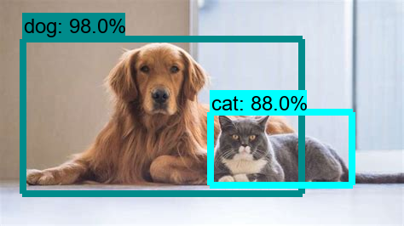
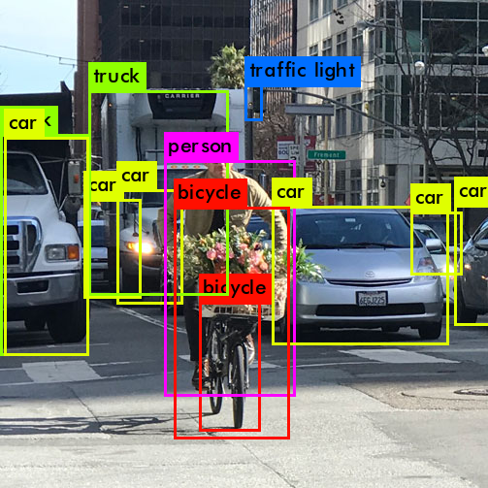
EXAMPLE
If A Blind Person Uses The Software, Then If He Opens The Camera Of The Software Through Voice Command, What Is The Object In Front Of Him, What Is The Object Doing, And What Is His Emotion Will Tell All The Software. If An Object Cannot Speak, It Will Be Able To Communicate With The User Through Cultural Symbols.

Slide 4
MOTIVATION
There Are Many People In The World Who Can't See, Can't Speak, Can't Hear. I Came Up With The Idea Of Making Software To Make Their Life Journey A Little Easier.
I Want Them To Live A Normal Life Like Us. So That They Can Use Smartphones Like Us.
I Will Update My Software In The Future According To The User's Requirements. I Will Make It More Secure.
I Will Add More New Features In The Future With The Mentioned Features.

Slide 5


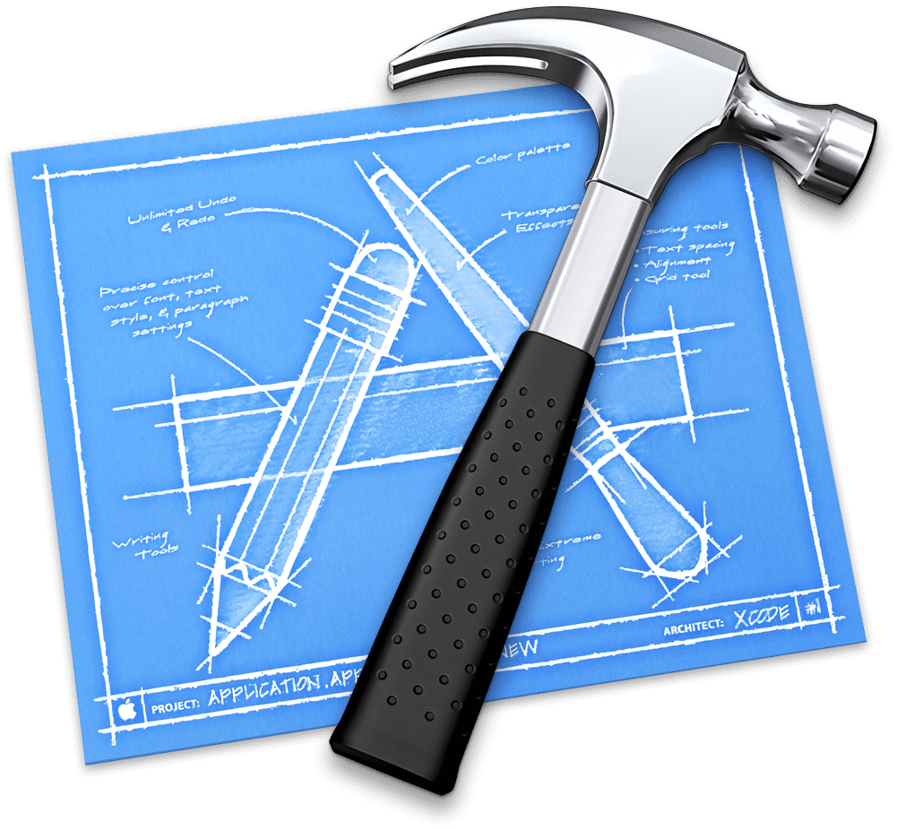



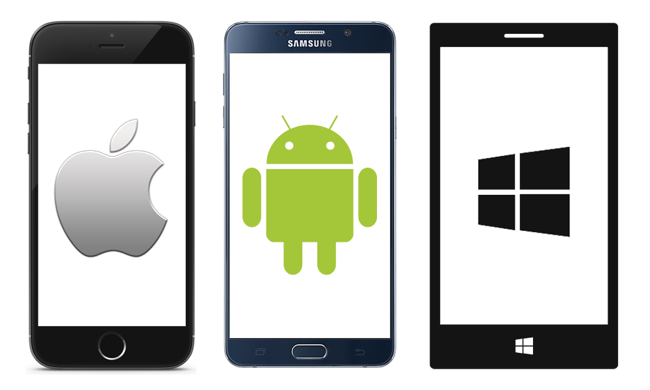





TOOLS
Tools: Android Studio, VS Code, XCode.
Platform: Android, iOS, Mac, Windows, Web.
Emulator: Android, iOS.
Language: Dart.
Framework: Flutter
Database: Firebase, Google Cloud.
Data Train: Teachable Machine, Dialog Flow.
Icon Design: Adobe Illustrator Cc 2021

Slide 6
FEATURES
Object Detection By Video
Object Detection By Image
Object Detection By Pose
Voice Read & Speak Answer
Chatbot
All Output Is Shown In Voice & Text
Users Can Update The Object
Users Can Feedback & Rating

Slide 7
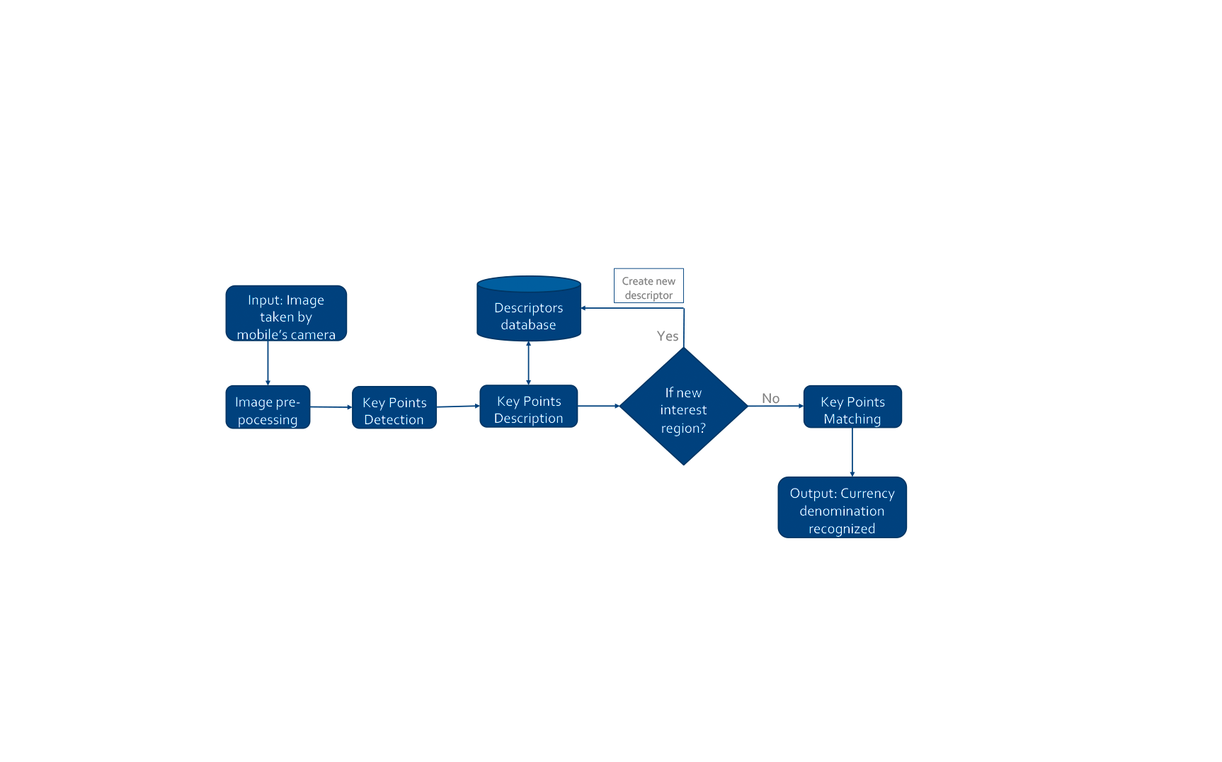
FLOWCHART

Slide 8
DIAGRAM
Settings
Home
Choice option
Input data
Output data
Choice option
Function
Premium
Rattings
Home
Choice option
Chatbot
Feedback
Object Detection
Step 1
Step 2

Slide 9
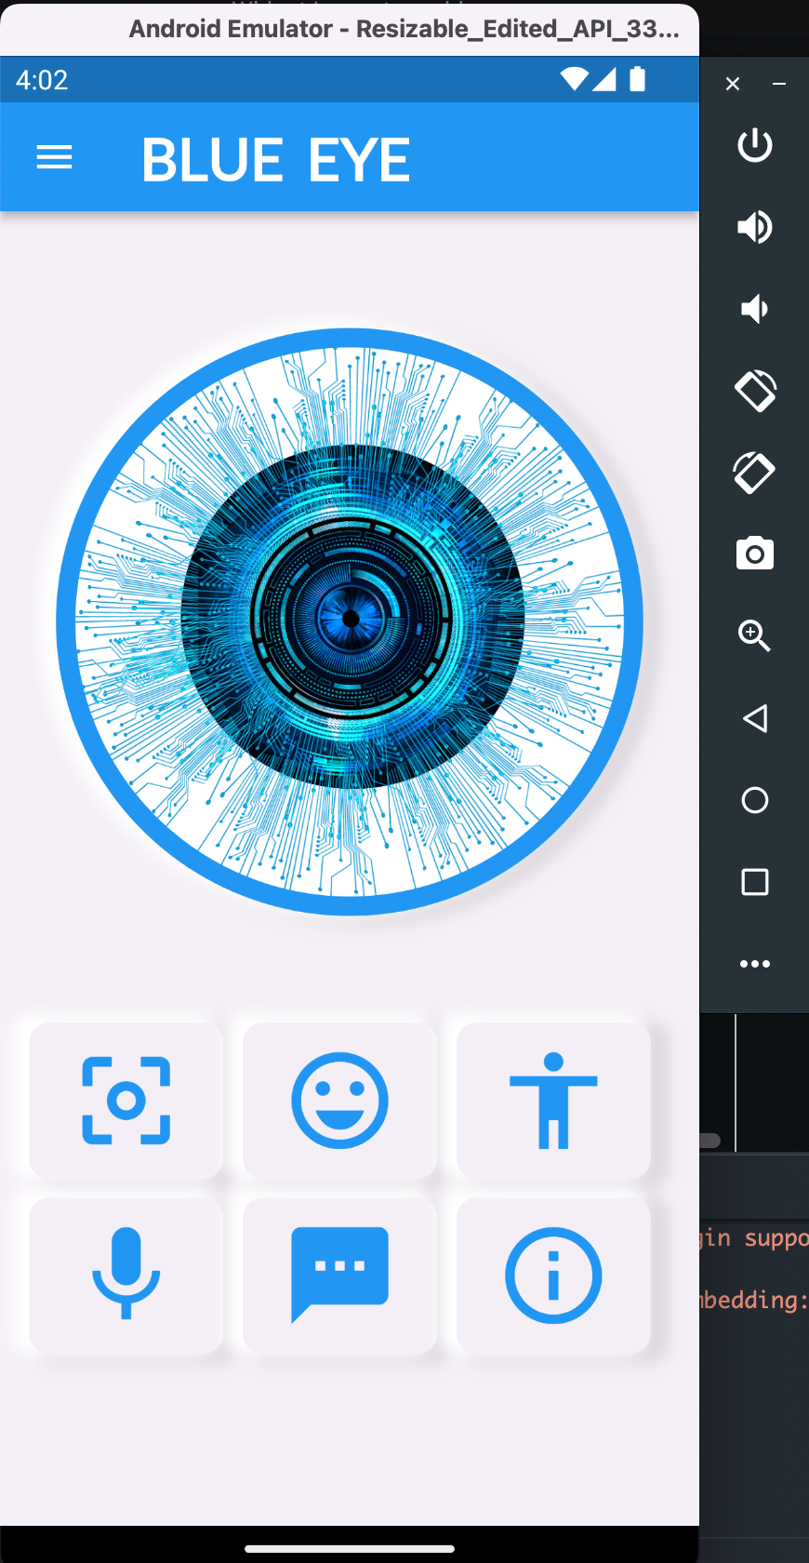
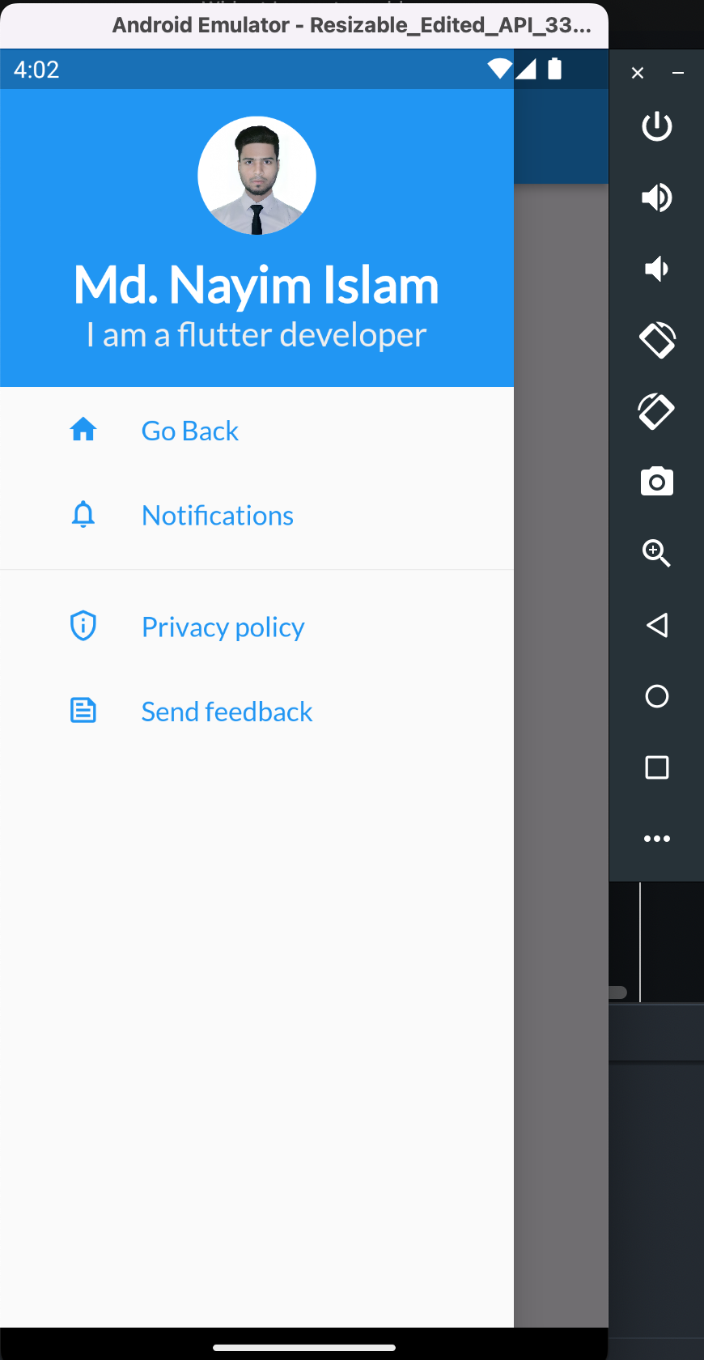
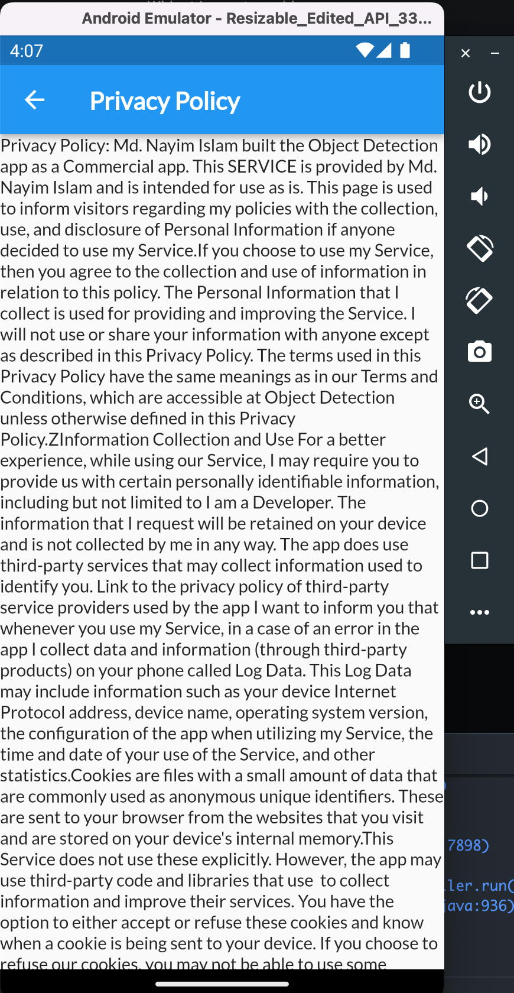
OUTPUT

Slide 10
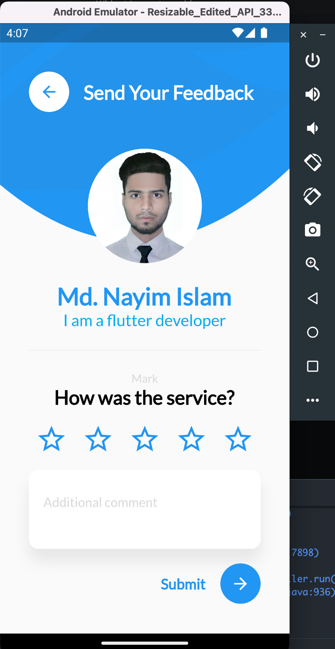
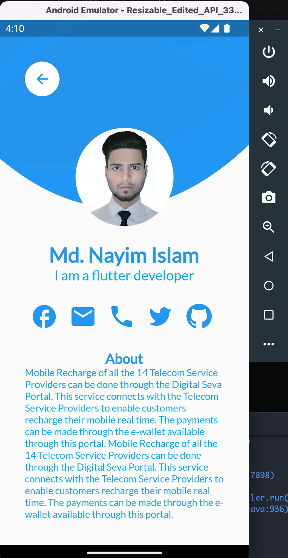
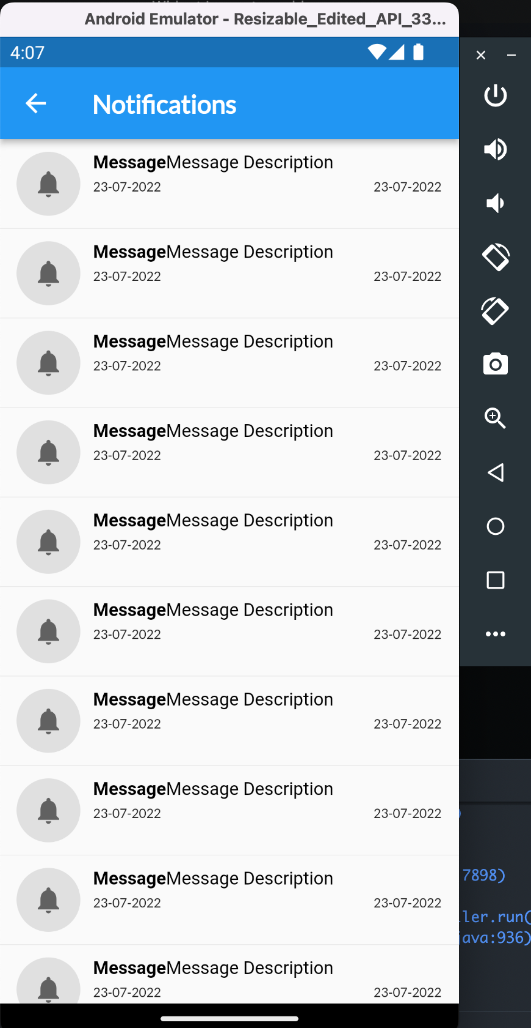
OUTPUT

Slide 11
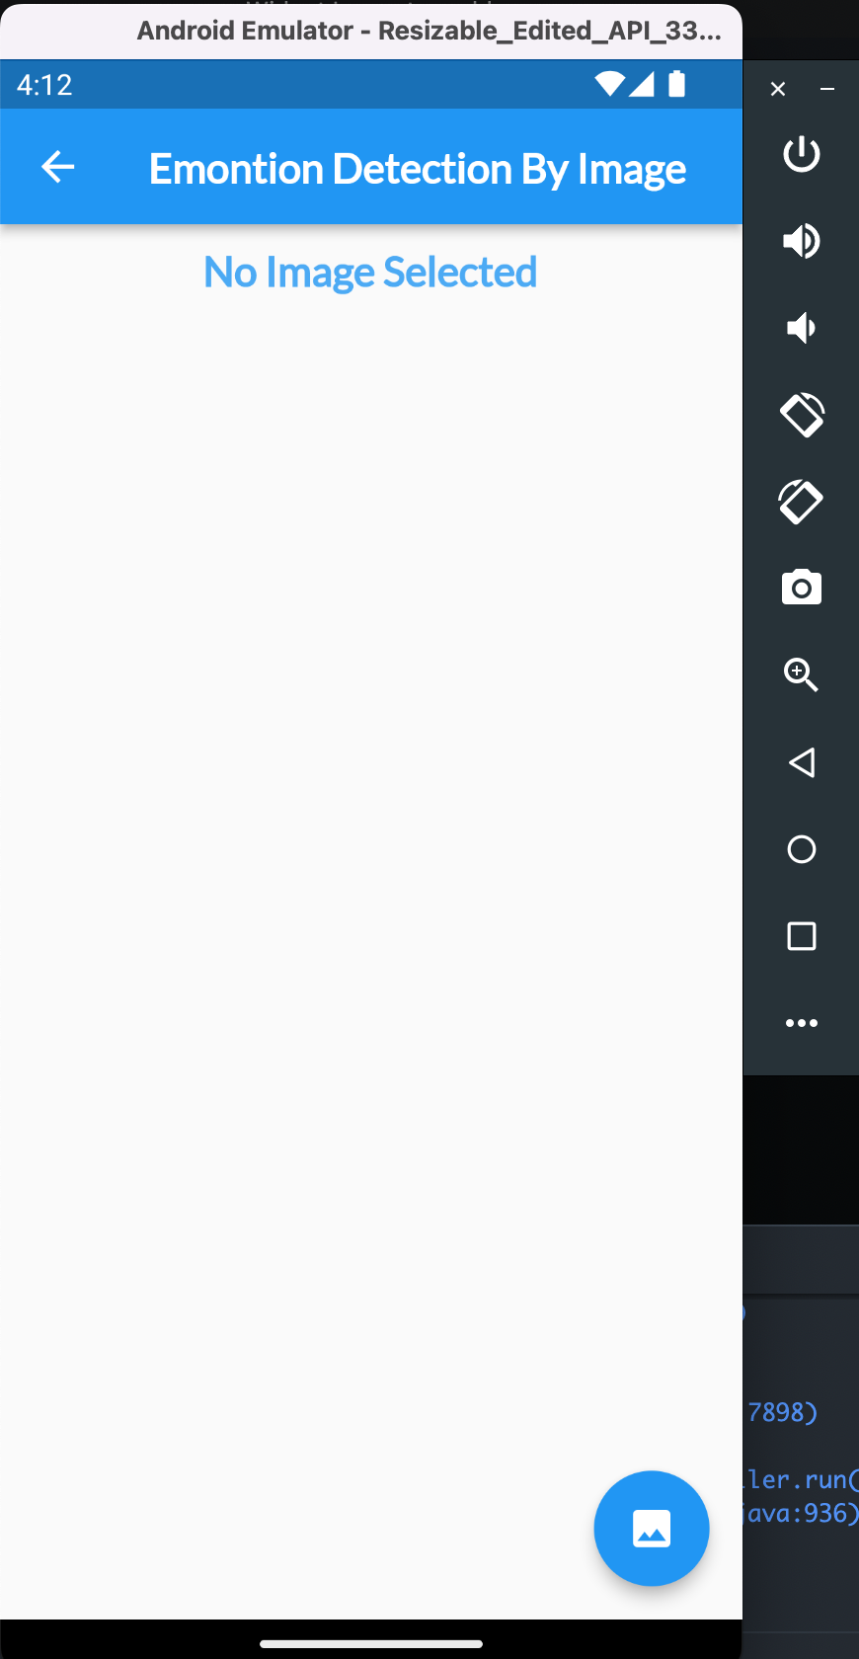
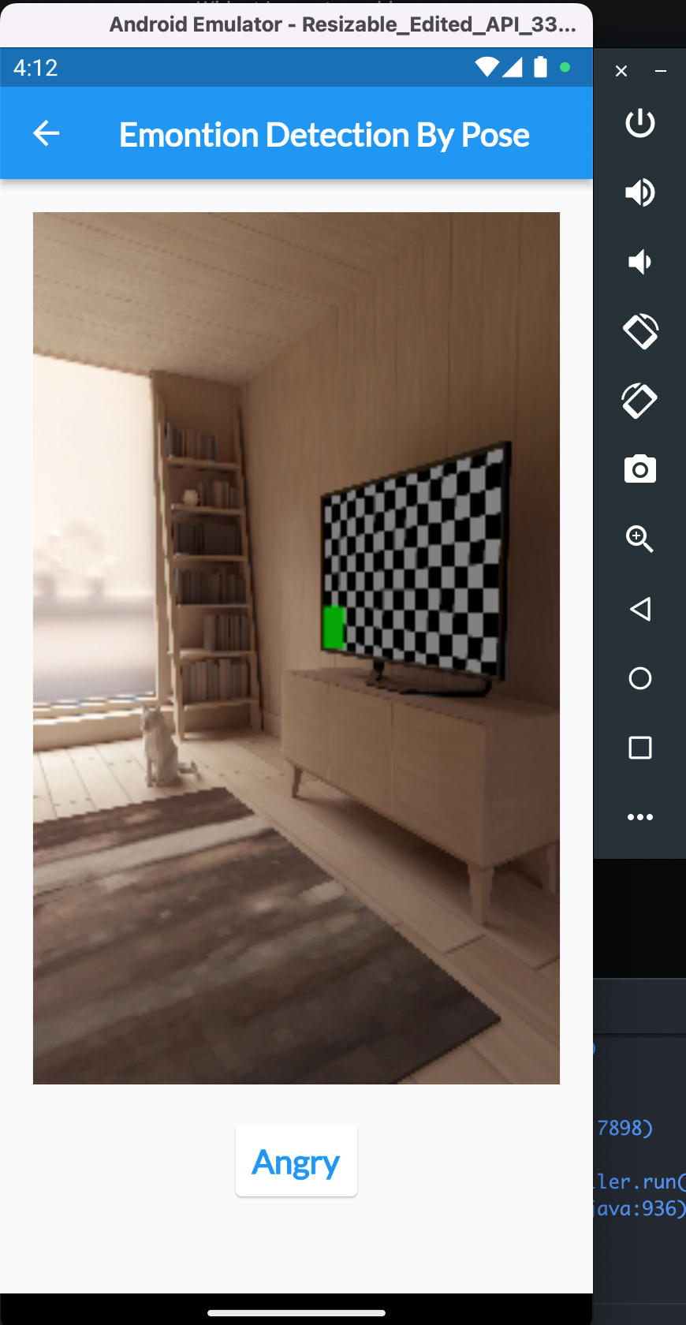
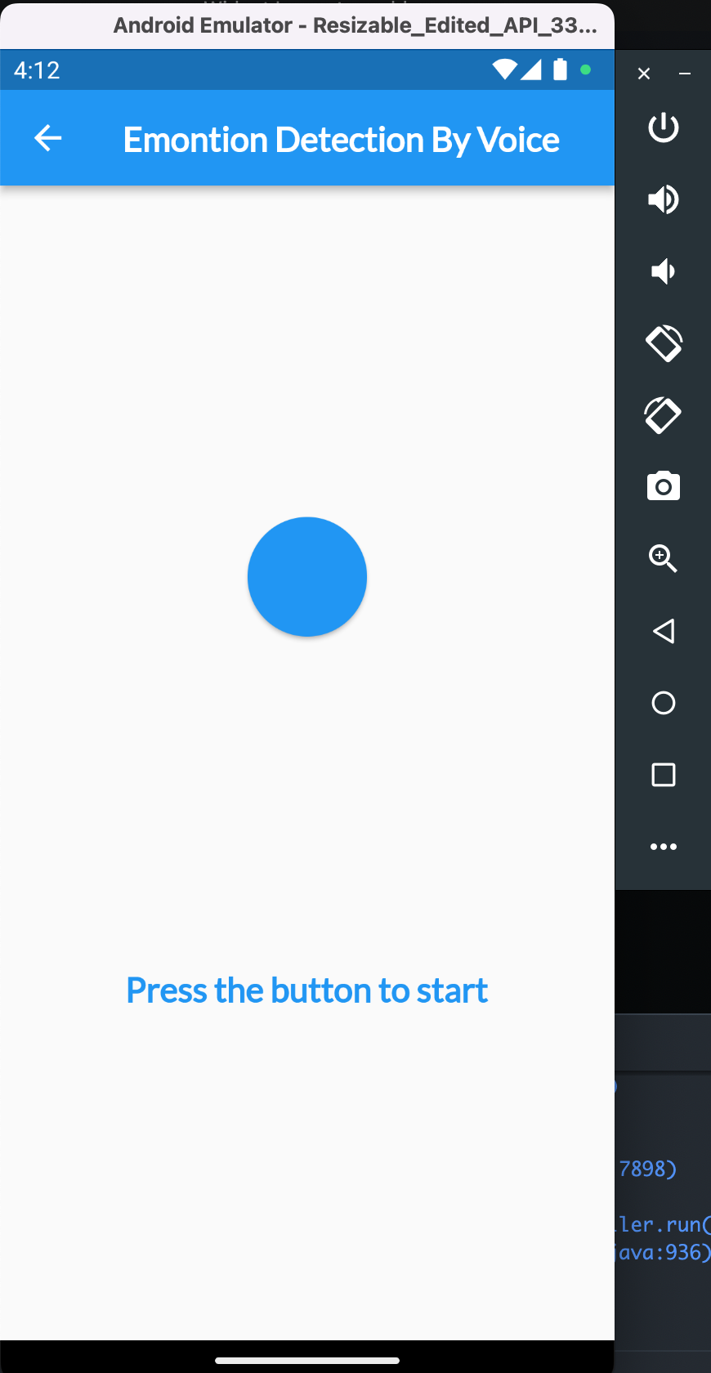
OUTPUT

Slide 12
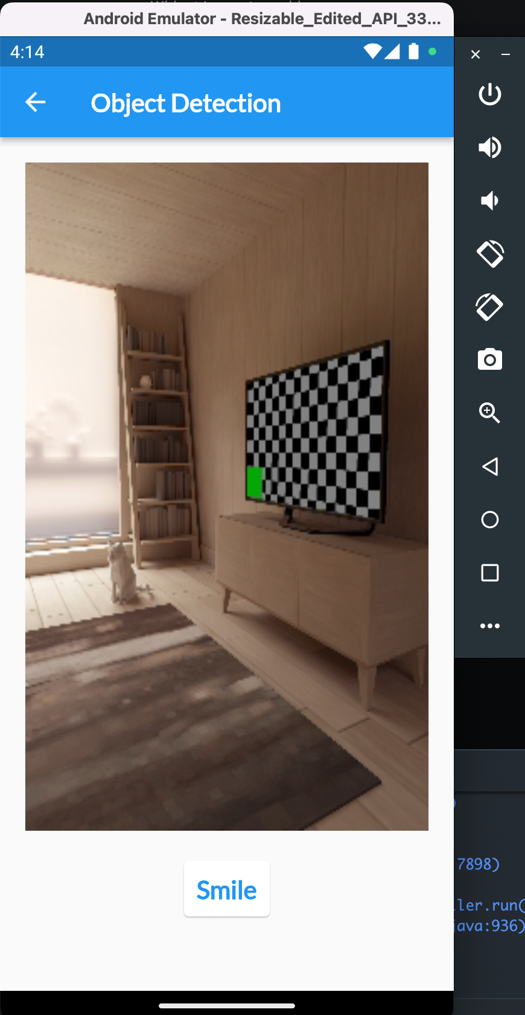
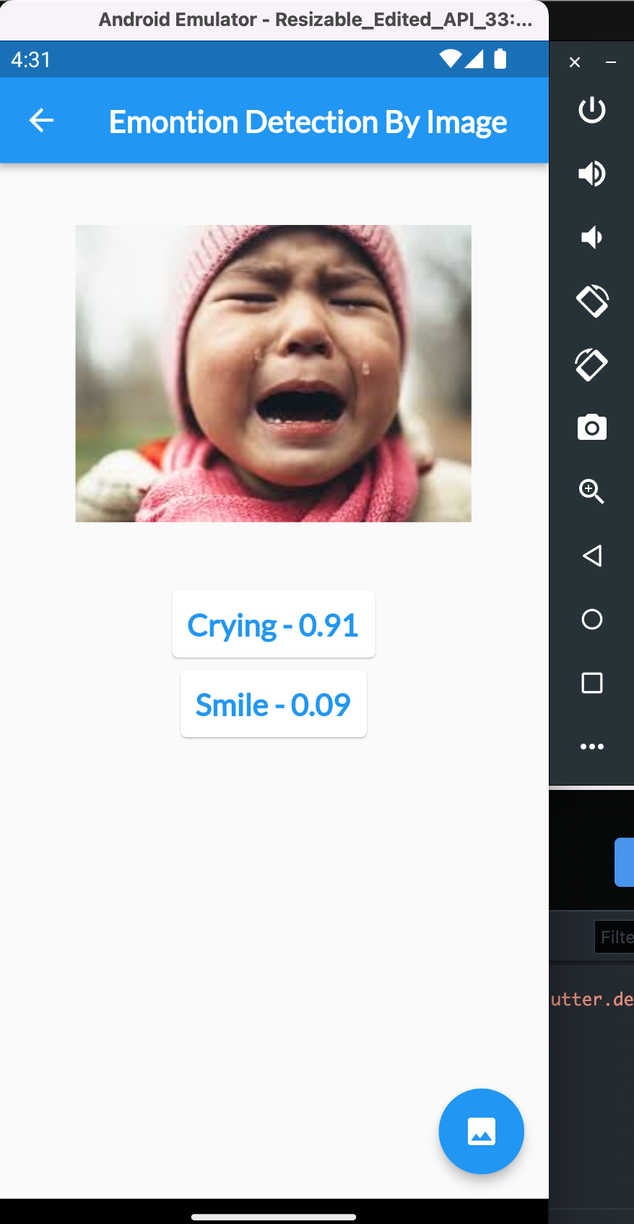
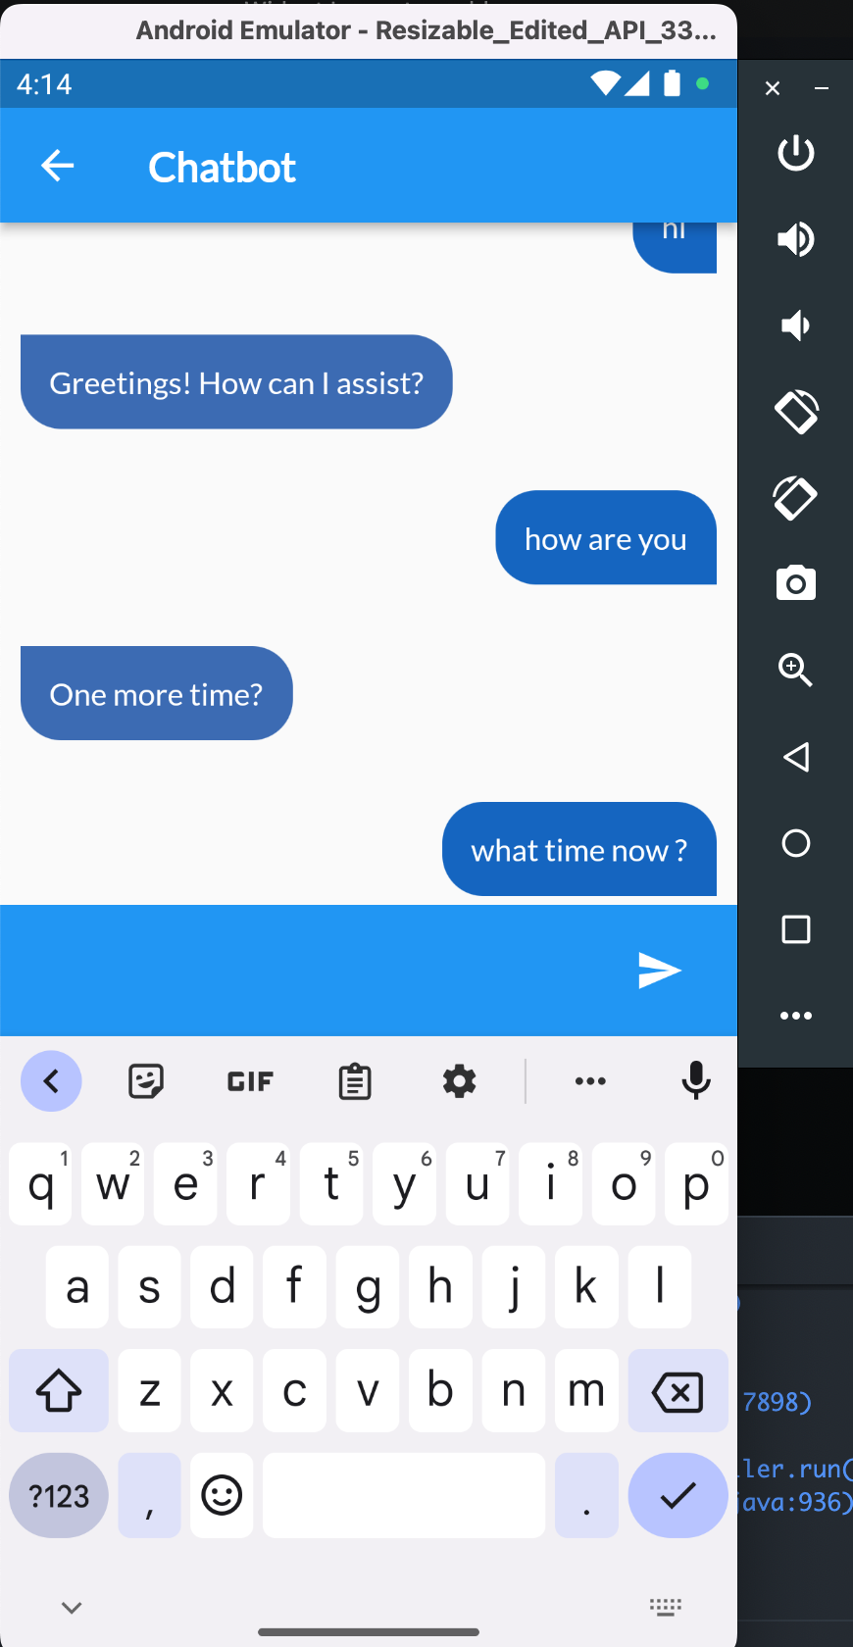
OUTPUT

Slide 13
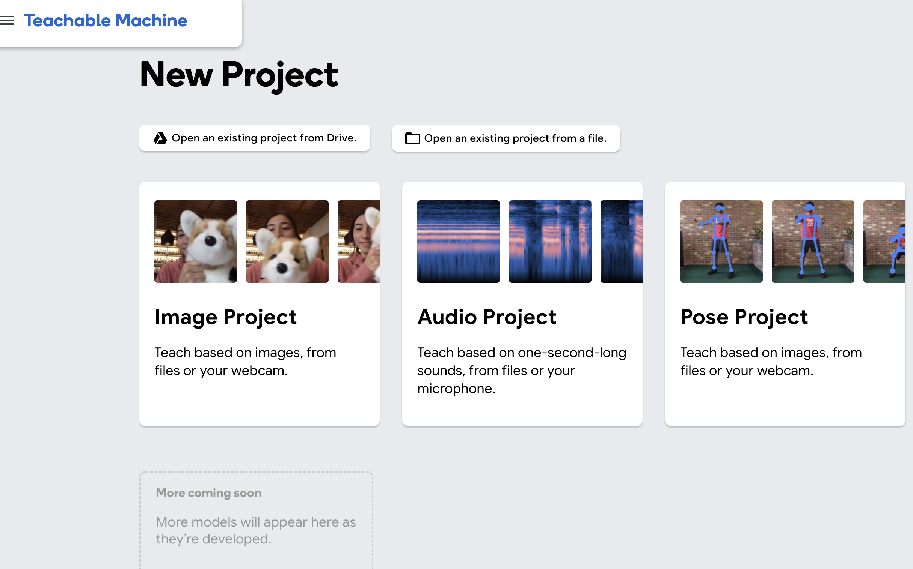
TEACHABLE MACHINE

Slide 14
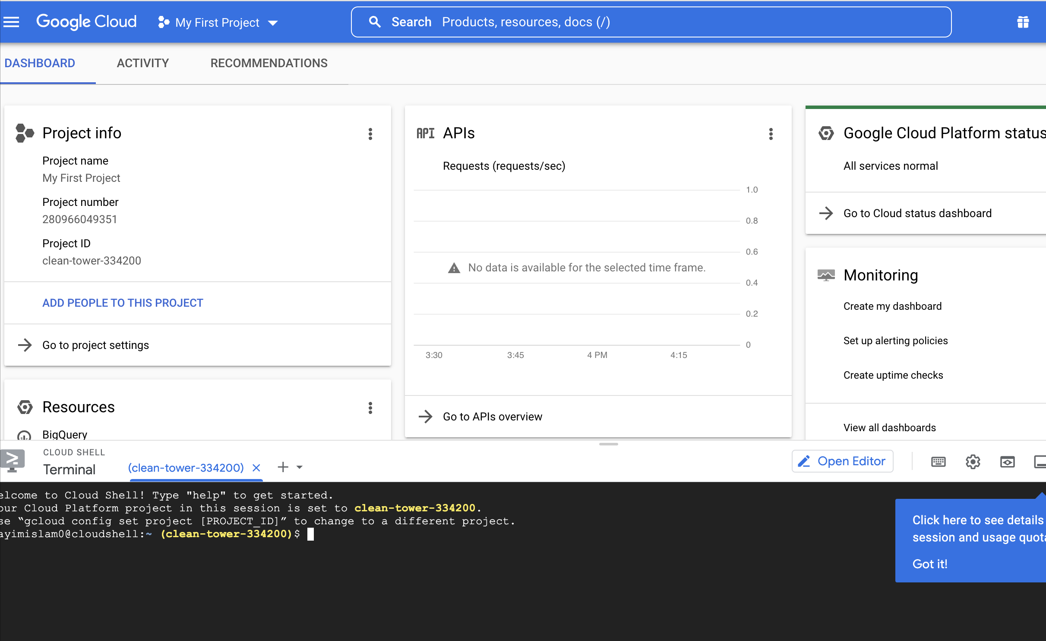
GOOGLE CLOUD

Slide 15
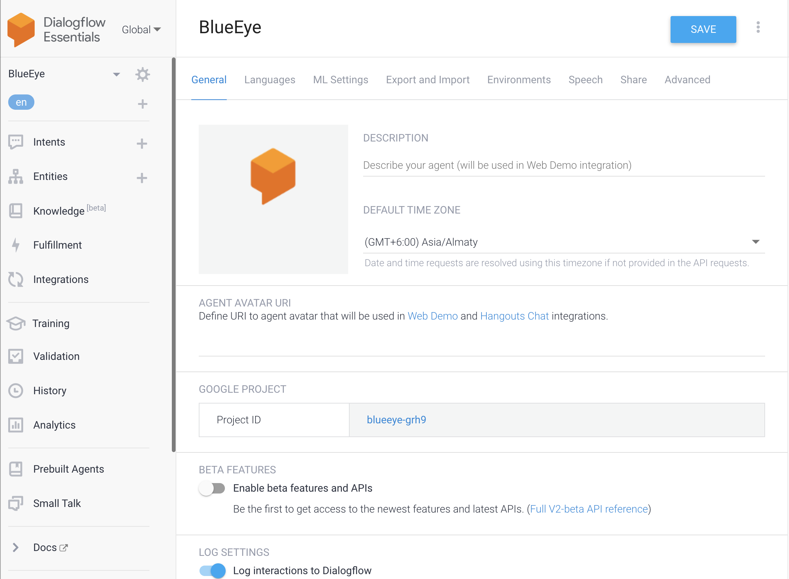
DIALOG FLOW

Slide 16
PLANNING
Since The Project Has To Be Completed Alone In A Very Short Time, There Are Many Errors In The Project. If I Had Some More Time I Would Have Been Able To Solve The Error Of The Project. My Plan Is To Add The Premium Version Of This Project With Some More Time. The User Can Learn The Object As Per His Own Wish And The User Profile Will Be Completed. I Will Complete My Project And Upload It To The Play Store And Update It Continuously.

Slide 17
CONCLUSION
Often There Is A Problem In Detecting The Same Type Of Object And Due To Very Low Detection Accuracy, It Often Shows Wrong Information. In The Case Of Chatbots, People Often Get Confused Because They Do Not Understand Emotions. Note That If There Is Too Much Noise, The Voice Assistant Will Do The Wrong Thing. I Will Try To Solve These Problems As Quickly As Possible And Reduce The Percentage Of Mistakes. I Will Give The Customer A Nice User Interface Next Update.

Slide 18
Application Link
Project Link: https://github.com/MdNayimIslam/blue_eye
APK Link: https://drive.google.com/file/d/1sMuJJIIk5HmMwOVjnFWfgm0I-JfBw8ud/view?usp=sharing

